Slide 1

SDN implementation GNS3
Emeka Ugwuanyi
ugwuanye@lsbu.ac.uk

Slide 2
Virtual box/ Virtual Machine
A virtual machine is an emulation of a computer system.
Virtual machines are based on computer architectures and provide functionality of a physical computer
In the coming weeks most of the tutorial activity would be done on a virtual machine
Virtual box helps to create a platform to run virtual machines

Slide 3
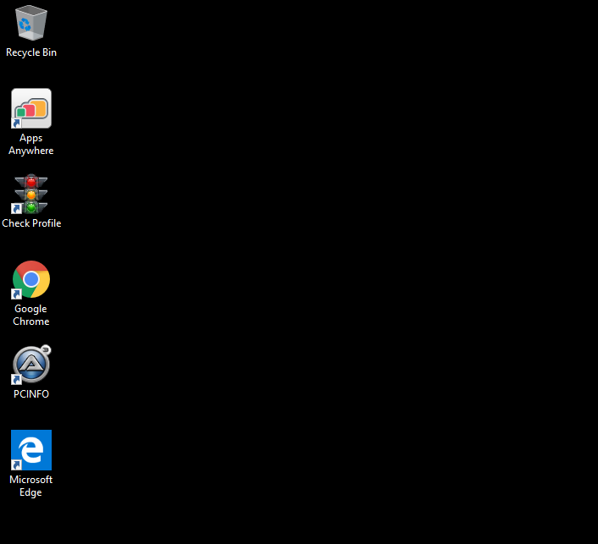
Steps to open Virtual box on your PC
Open Apps Anywhere

Slide 4
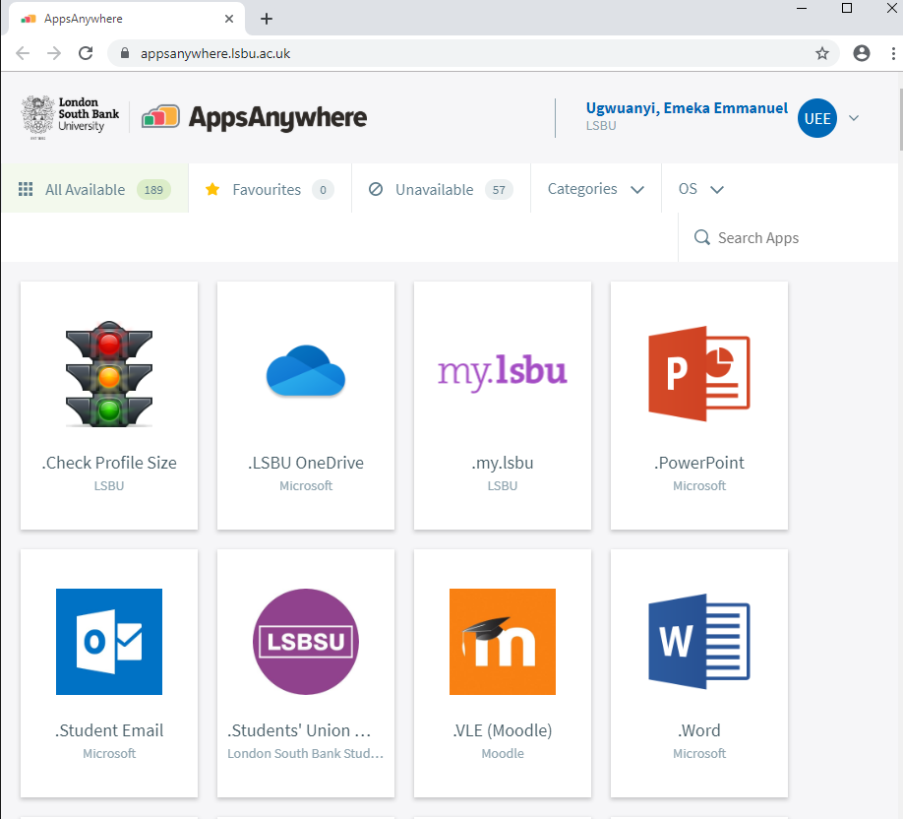
Steps to open Virtual box on your PC
Search for Virtual box

Slide 5
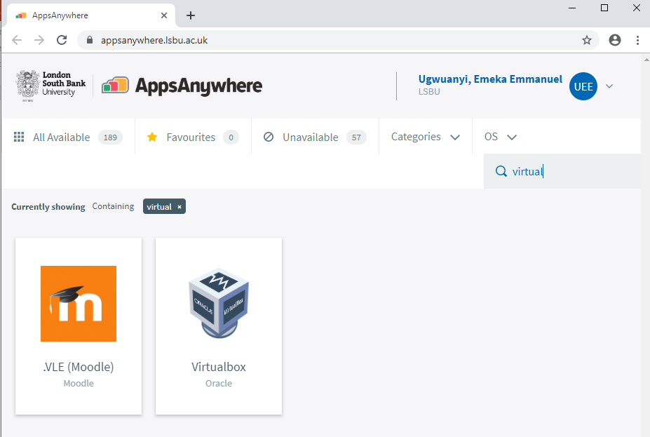
Steps to open Virtual box on your PC
Launch App

Slide 6
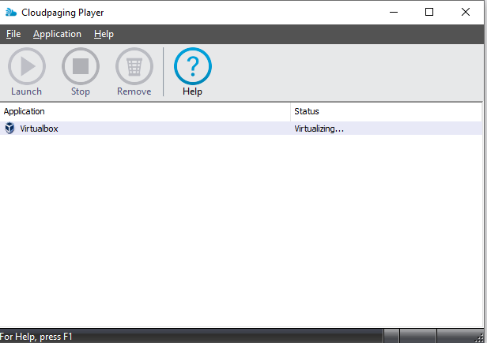
Steps to open Virtual box on your PC
A widget like this should pop up

Slide 7
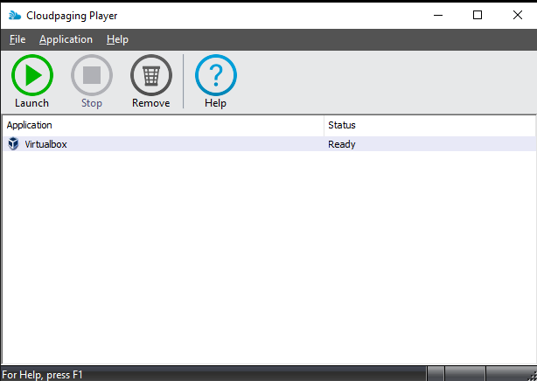
Steps to open Virtual box on your PC
Launch when ready

Slide 8
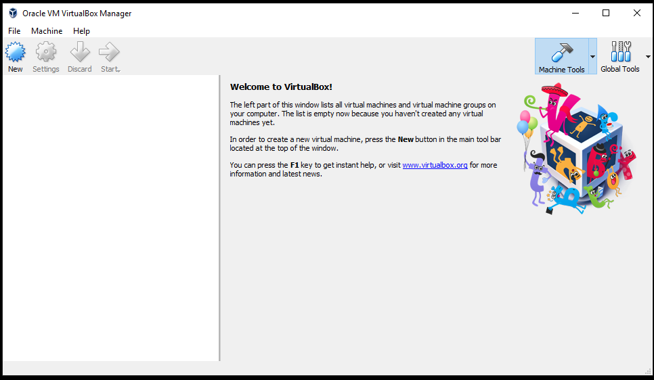
Steps to open Virtual box on your PC
The virtualBox application should open like below

Slide 9
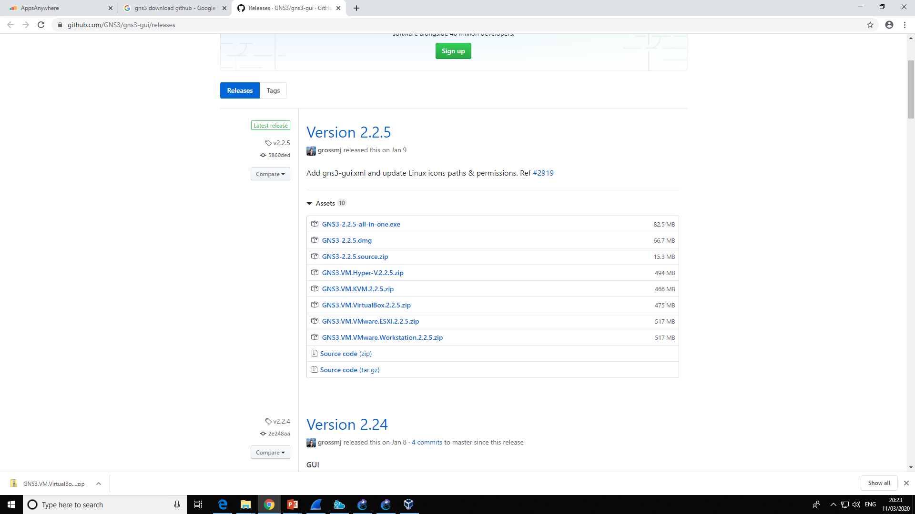
Download GNS3 VM for VirtualBox (download on your C drive)

Slide 10
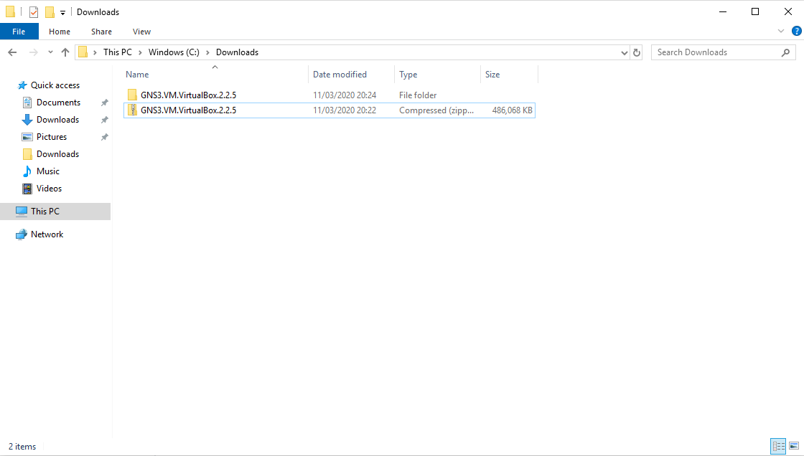
Extract the files after download

Slide 11
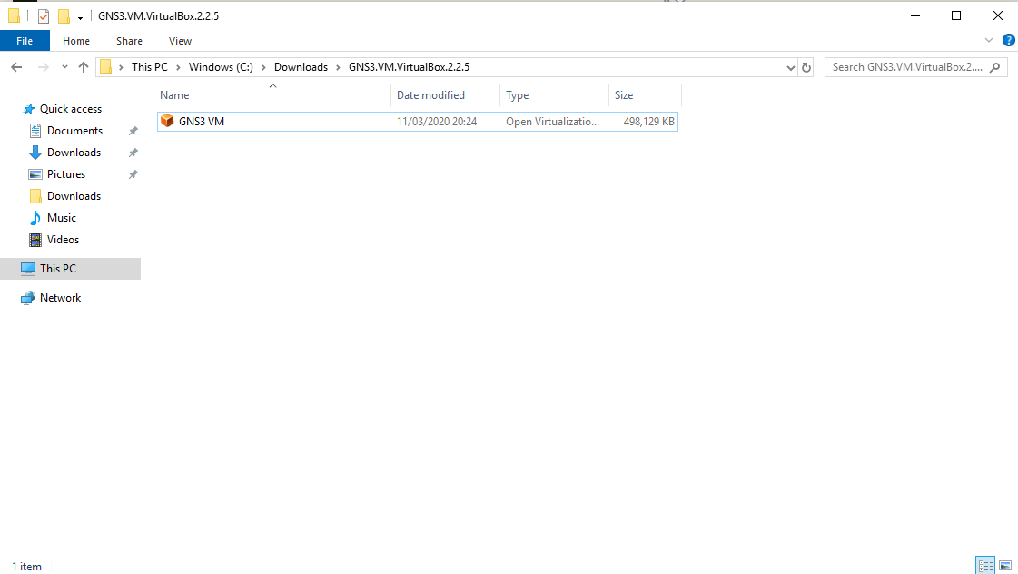
Double click to open in VirtualBox

Slide 12
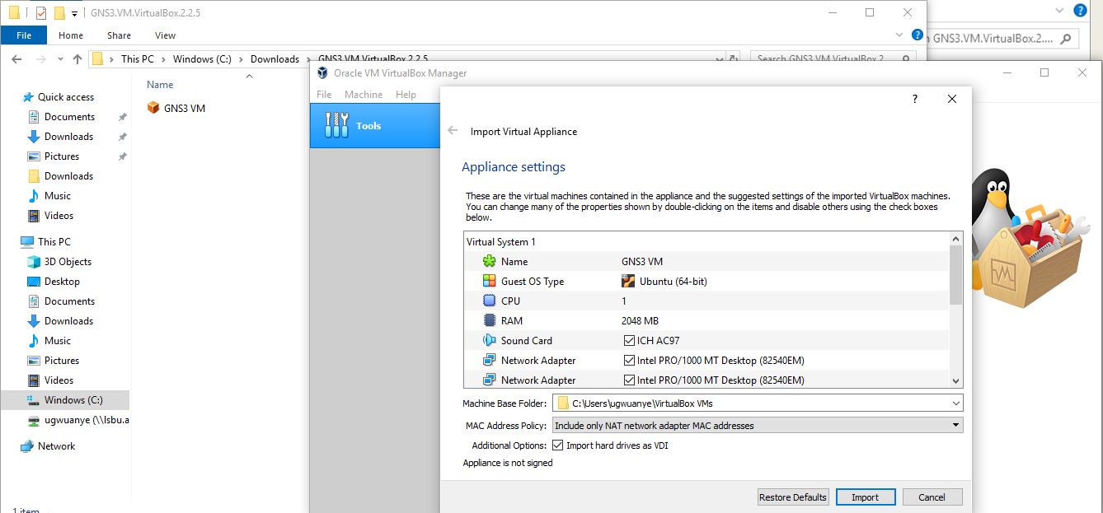
Now some parameters need to be changed

Slide 13
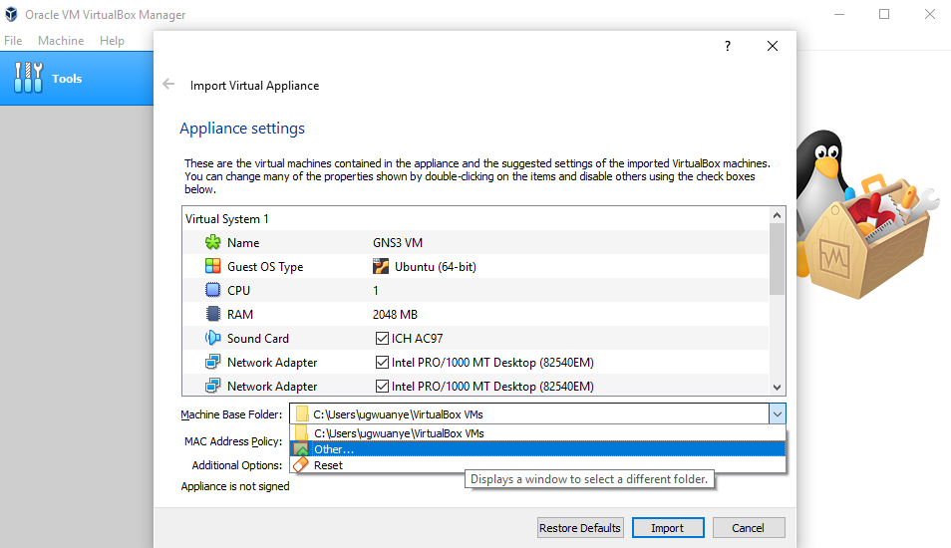
Select Other like shown below

Slide 14
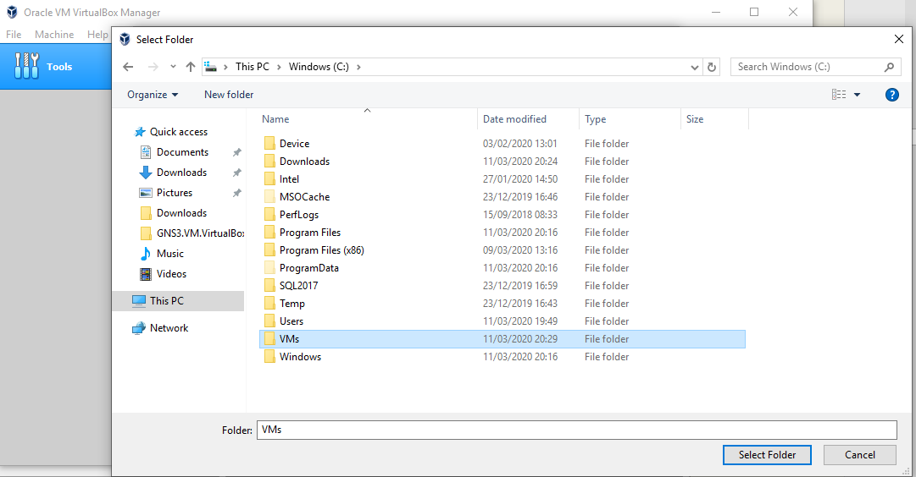
Navigate to your C drive and create a folder called VMs and select folder

Slide 15
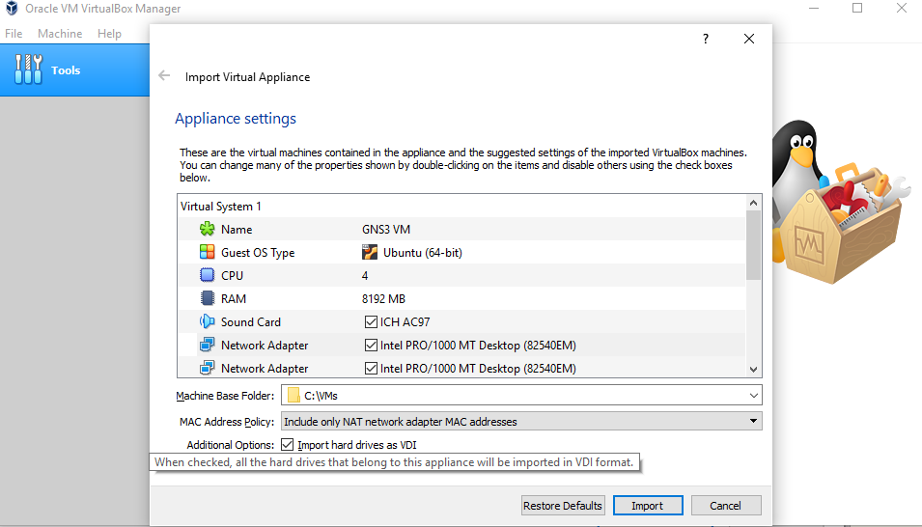
Adjust the parameters below to match CPU and RAM. Then select import

Slide 16
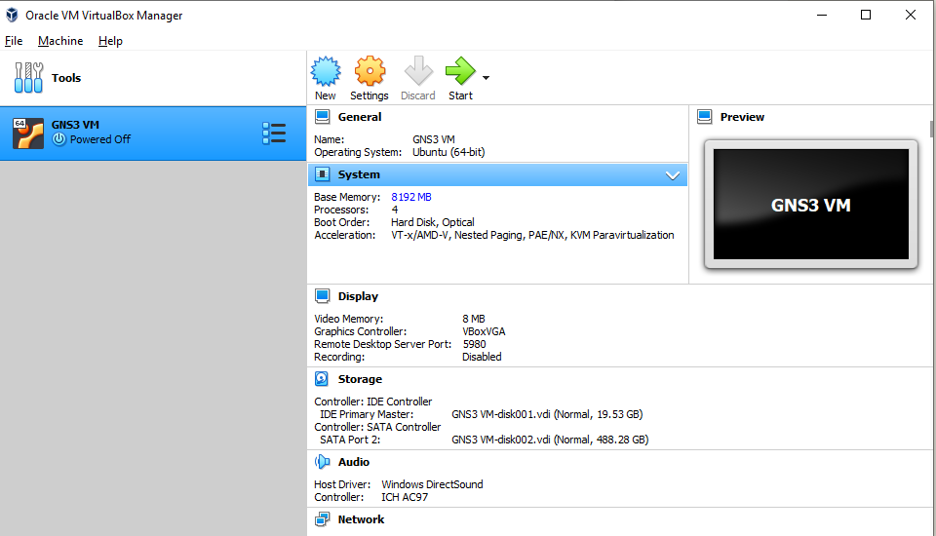
After import click on settings

Slide 17
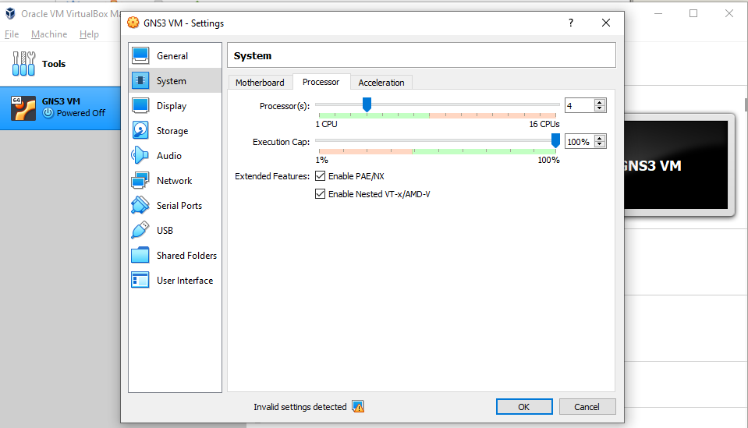
Select system and click on processor. Then enable these parameters
Click ok. Then start the VM

Slide 18
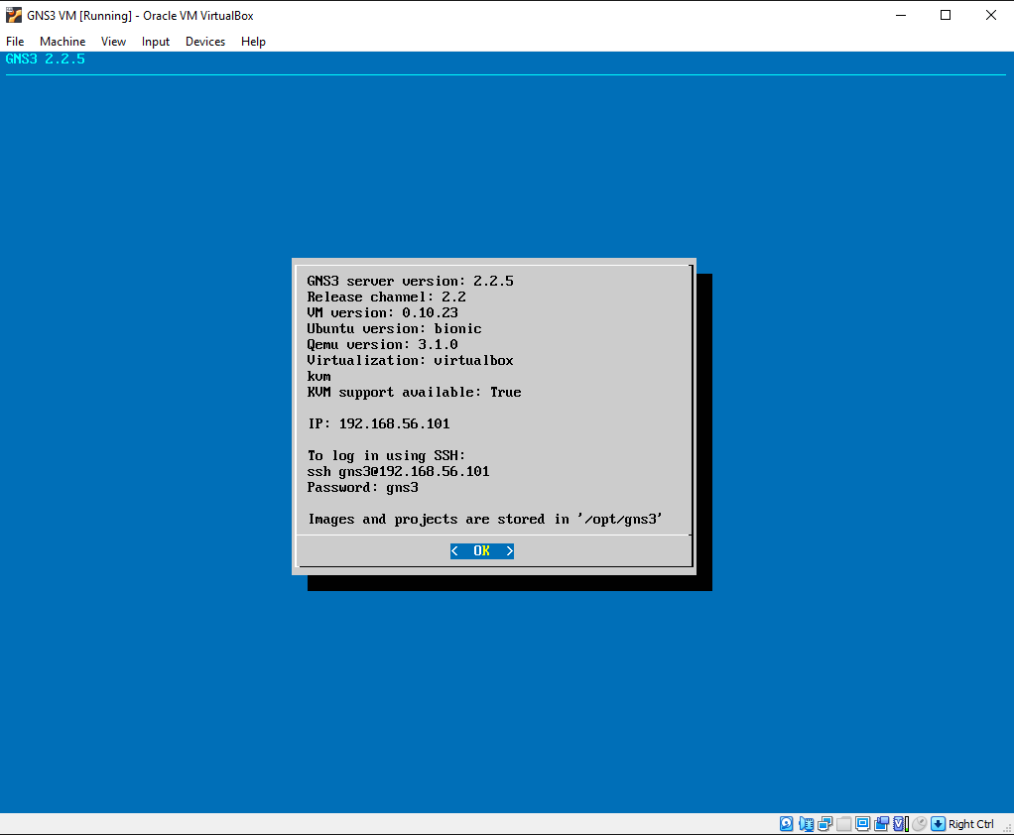
Running VM

Slide 19
Steps to Start GNS3 APP
Go to apps anywhere
Click in the Search Apps box and start typing GNS3 - GNS3 will be displayed.
Click Launch.
There are a few things to be aware of:
1. Wireshark will be opened first as GNS3 requires Wireshark to be installed. You can close it if you don't need it open.
2. Before starting GNS3 you will need to start the GNS3 local server by clicking the 'Start Local Server' shortcut. If this is not done first GNS3 will have trouble connecting to the local server.

Slide 20
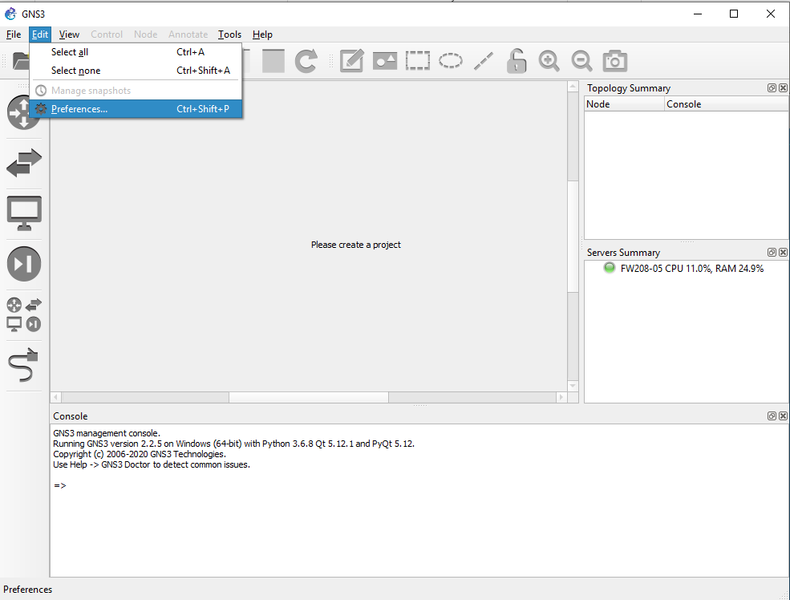
After successful GNS3 Launch. Click on edit and select preference

Slide 21
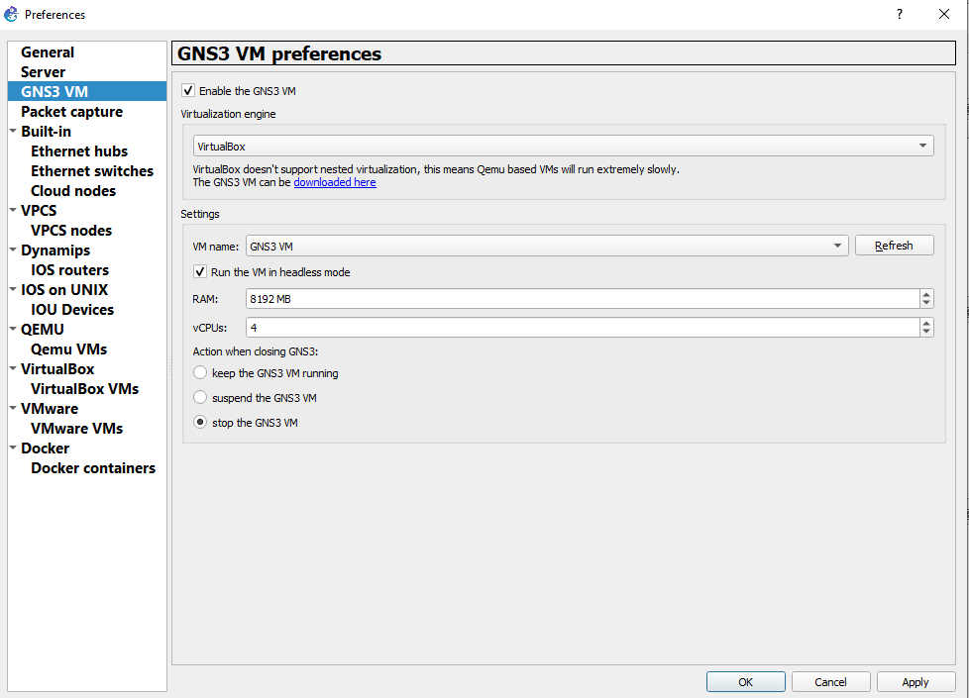
Select GNS3 VM. And edit these preferences to match. Then click apply and ok

Slide 22
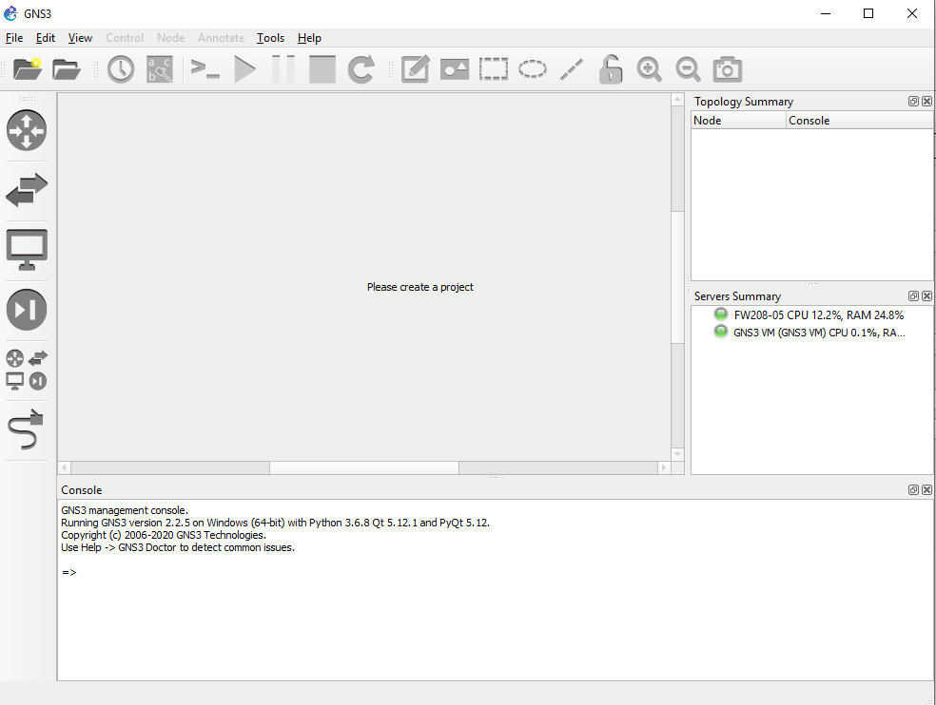

Slide 23
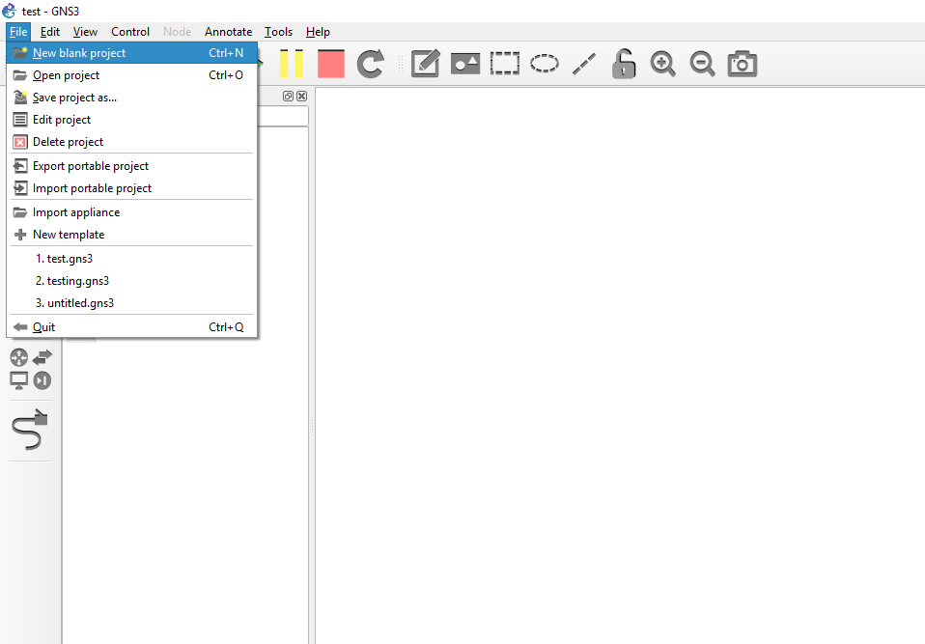
To create a new project. Select File >> New blank Project

Slide 24
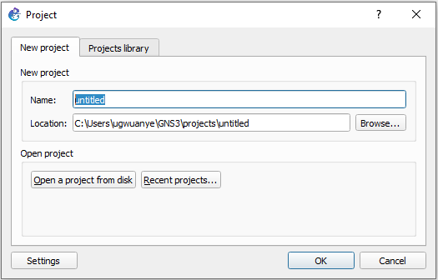
Name your project

Slide 25
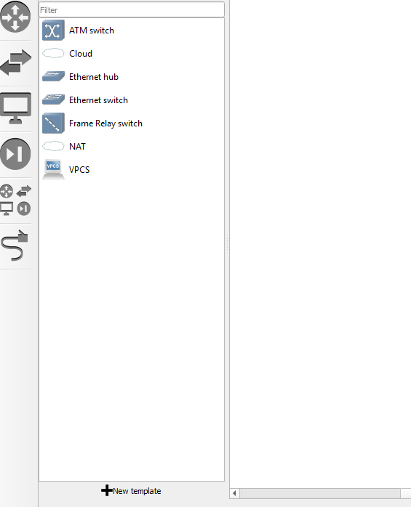
Now we are going to add template
Of devices to work with.
Select Template and follow the
following steps

Slide 26
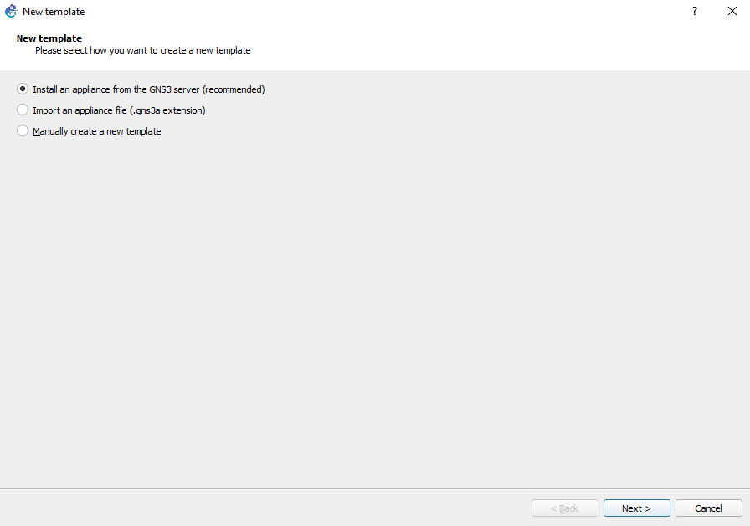

Slide 27
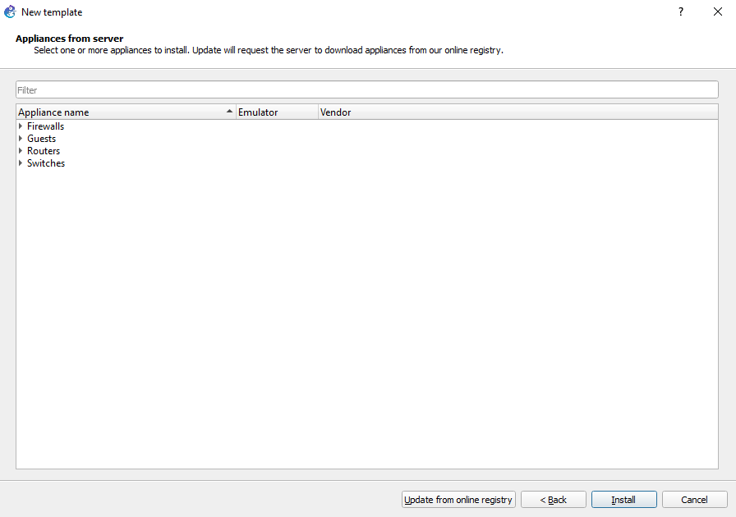
Select Switches >> Open vswitch Management >> install >> next >> finish

Slide 28
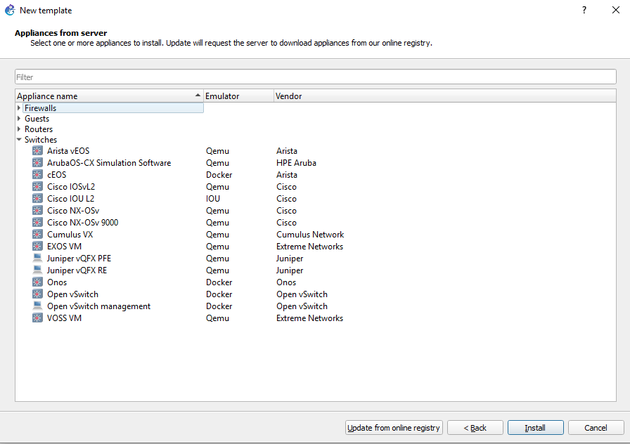
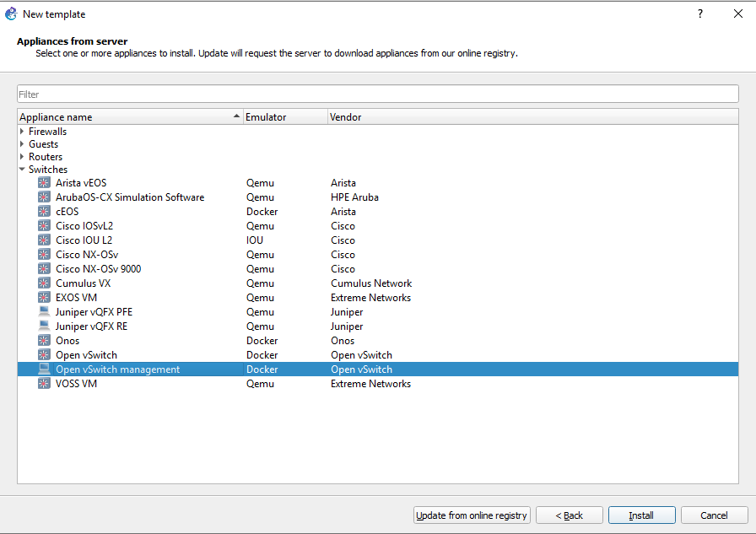
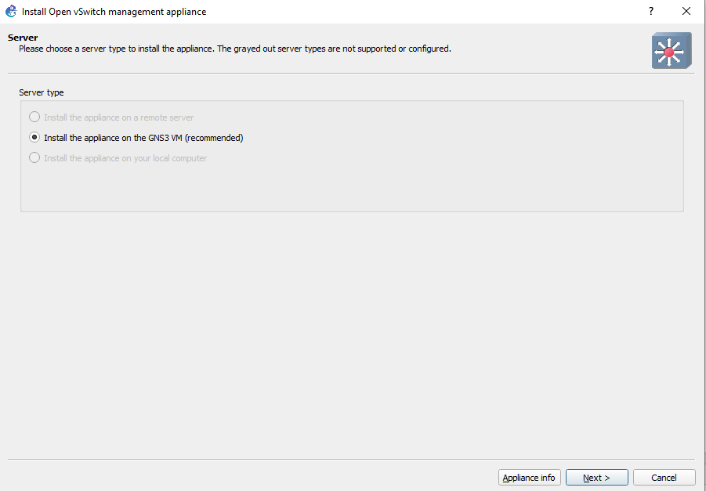
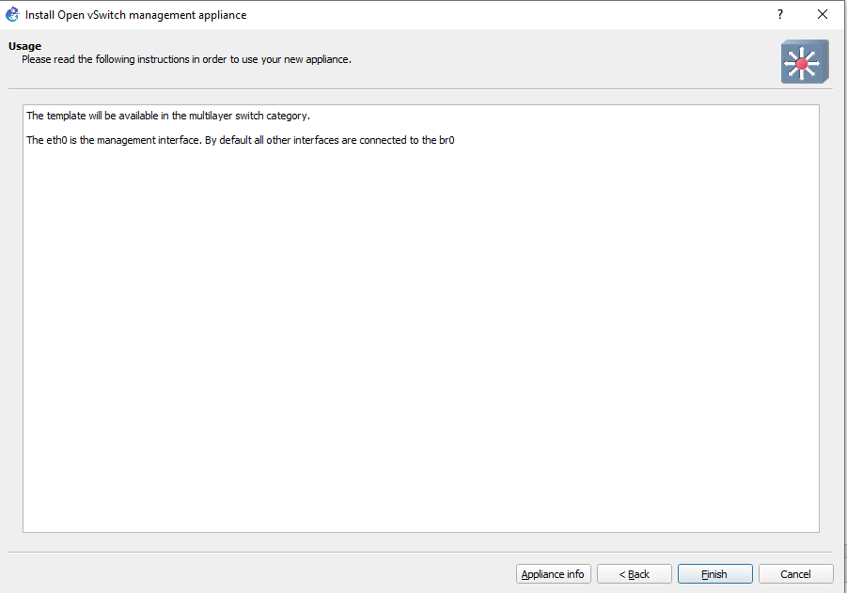
1
2
3
4

Slide 29
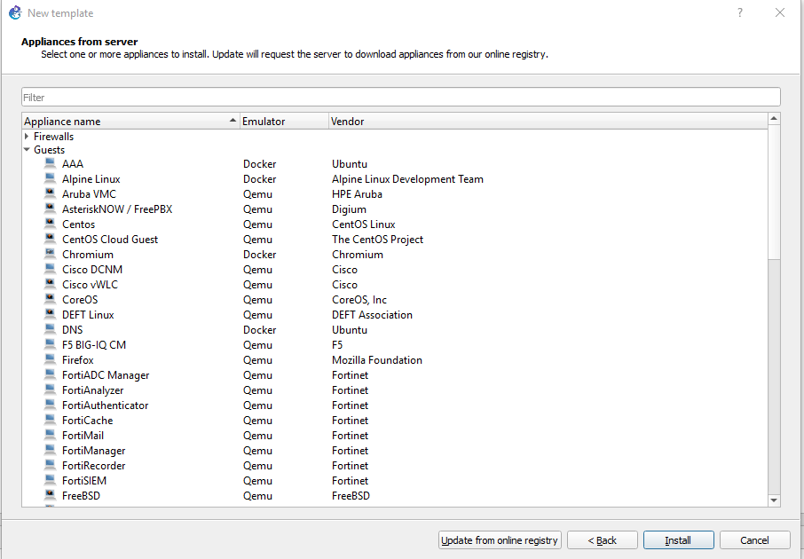
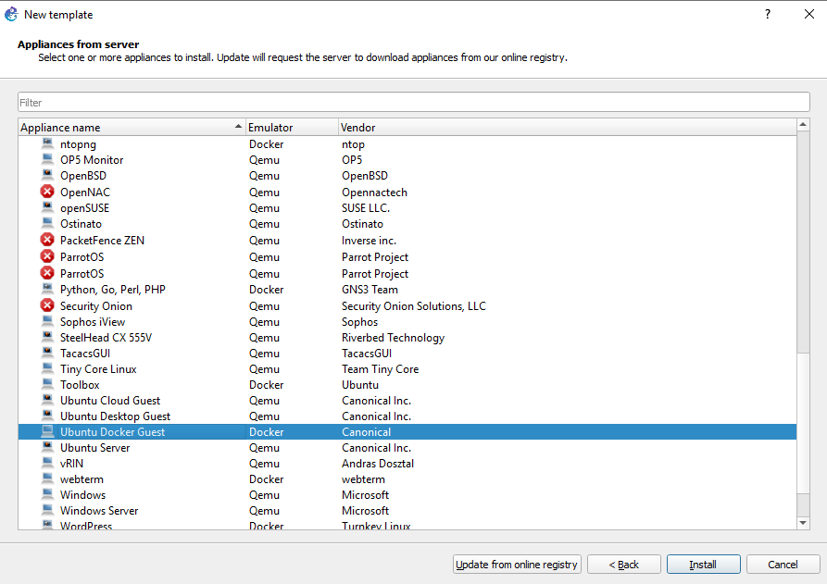
Now go to templates >> guests:
Install ubuntu Docker Guest and Ubuntu Desktop guest

Slide 30
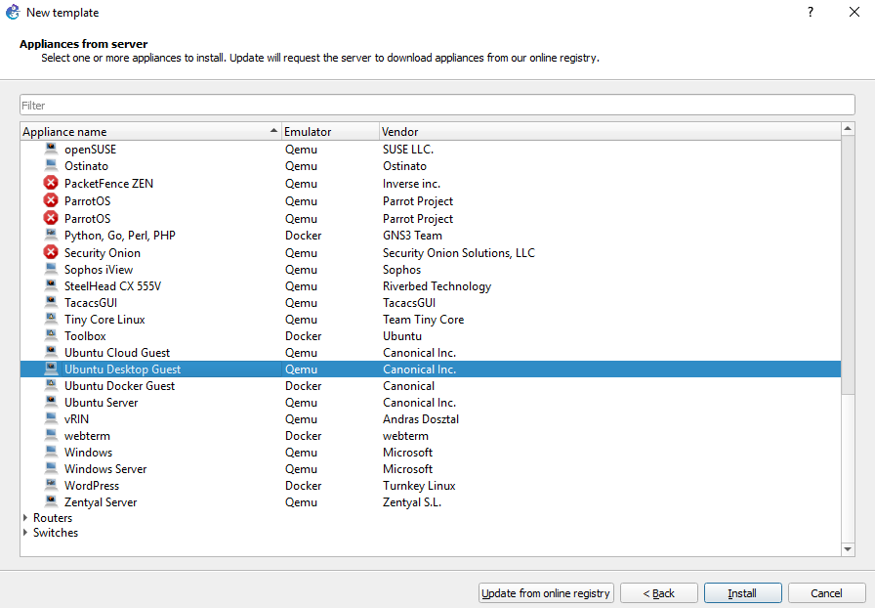
Install ubuntu desktop Guest

Slide 31
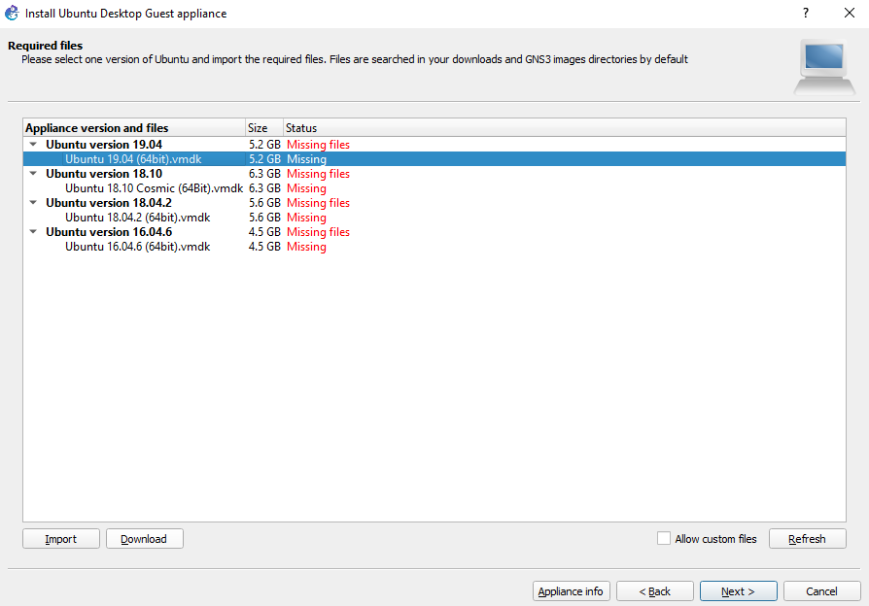
Download and extract file from the link below. The file is named 64. Then import
https://stulsbuac-my.sharepoint.com/:f:/g/personal/ugwuanye_lsbu_ac_uk/EtRpdMPg0R5PvGk9Nm0-K38Bu61geVNd-gSeOlUuDhSUag
download requires you login to your lsbu email

Slide 32
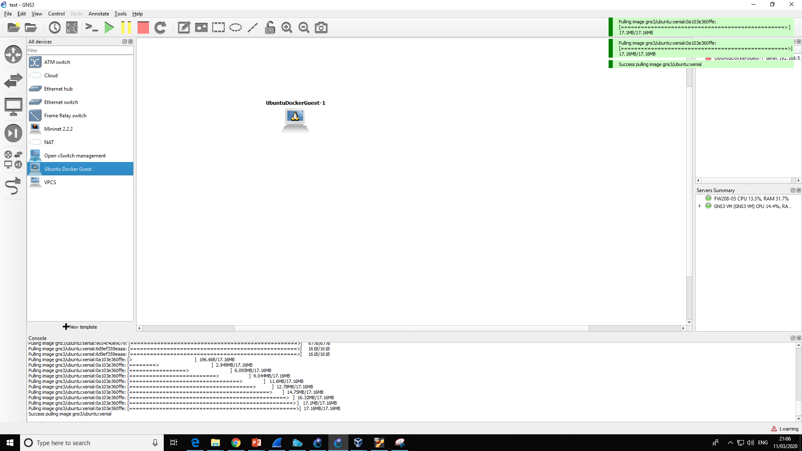
First time Dragging the device to the workspace

Slide 33
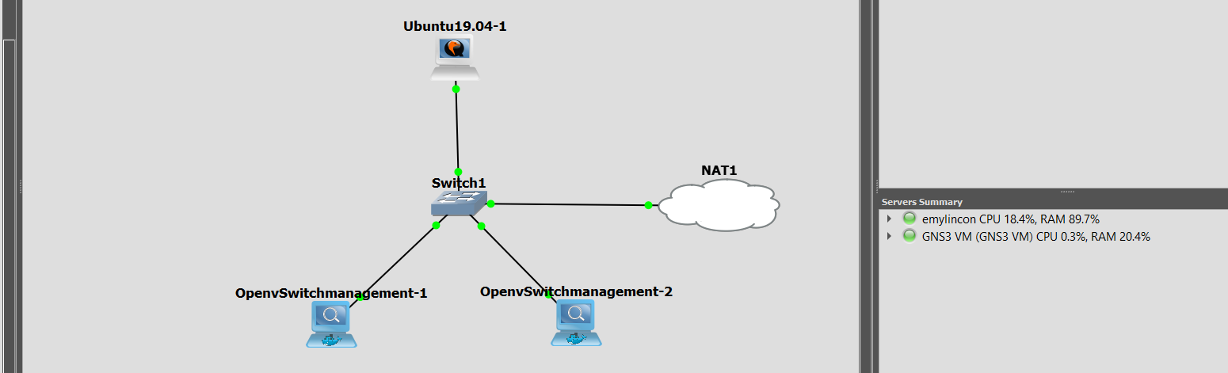
Create the following topology with your open vSwitch and ubuntu desktop guest

Slide 34
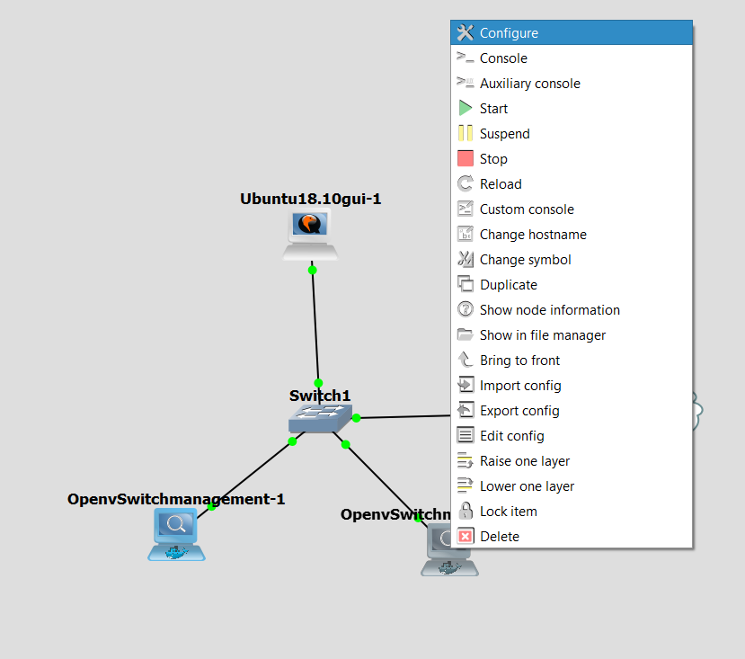

Slide 35
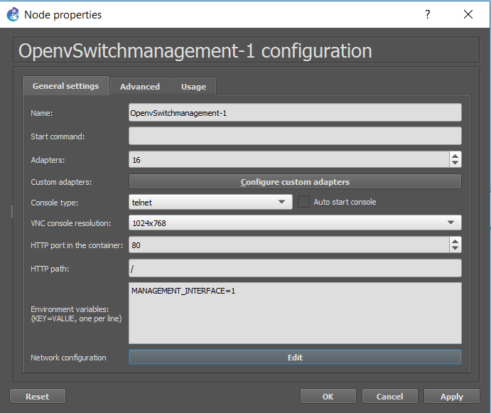
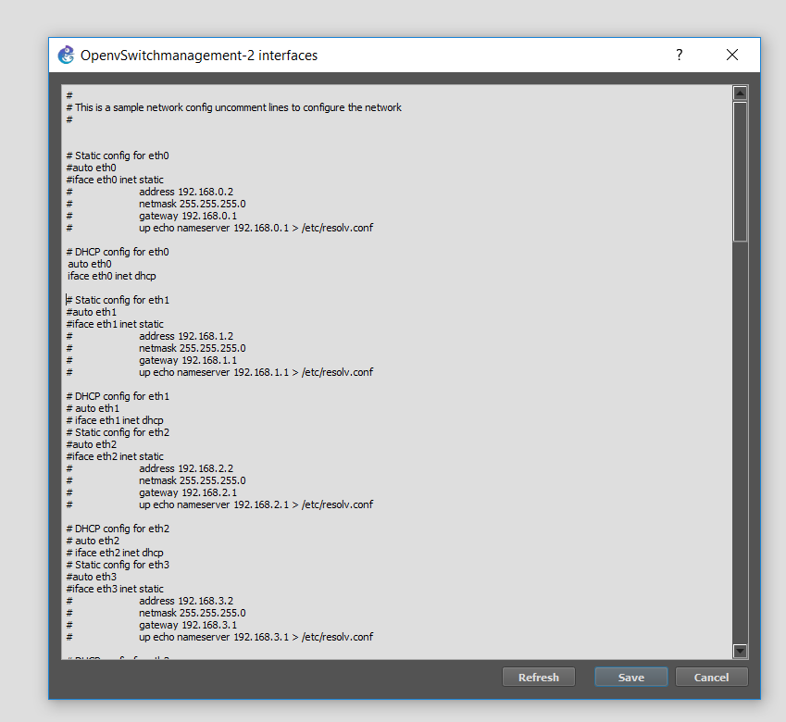
Remove the # Then save and apply changes

Slide 36
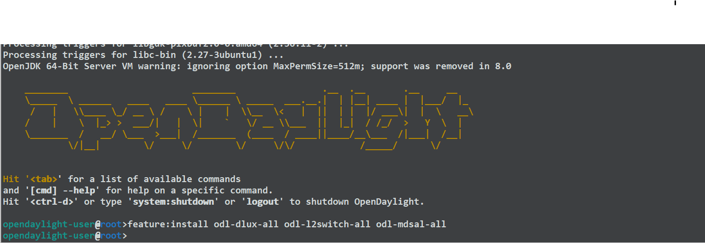
Configure ODL controller (ubuntu Desktop)
1. Download script from github
$ apt install git -y
$ Git clone https://github.com/emylincon/odl1
$ cd odl1
2. Run Ifconfig and note ip address
2.2 run script and install features
$ sudo bash odl_build.sh
$ feature:install odl-dlux-all odl-l2switch-all odl-mdsal-all
3. Wait for installation
4. Go to browser and open http://controller-ip:8181/index.html

Slide 37
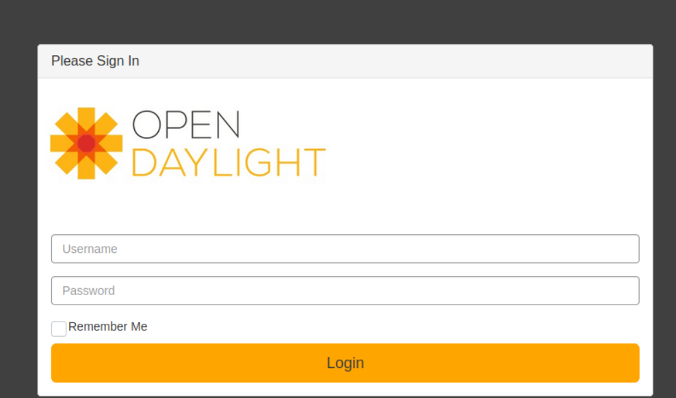
Username: admin
Passwors: admin

Slide 38
Ovs switches
Ovs-vsctl set-controller br0 tcp:controller-ip:6633

Slide 39
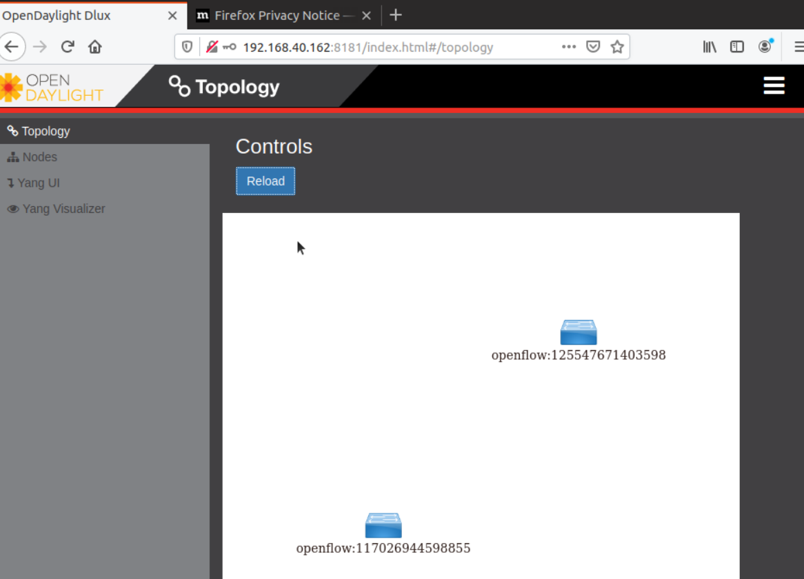
Go back to the controller and reload the browser

Slide 40
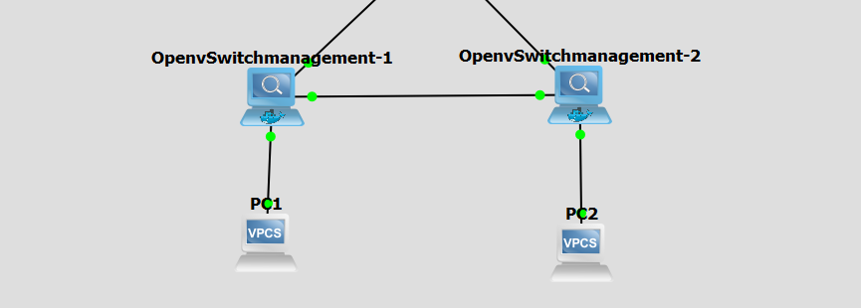
Change topology by linking the switches and adding two hosts

Slide 41
Open PC1
ip 192.168.100.1
Open PC2
$ ip 192.168.100.2
$ ping 192.168.100.1
Now go back to the controller to view the changes in the topology

Slide 42
Task
Further expand the topology with 5 switches and 3 hosts connected to each switch

